Slide 1
FASTA
BROWSER
Shreyas Badami
Kapil Rajesh Kavitha

Slide 2
Functional Requirements
1. Frontend (User interface)
a. Basic UI: React-based application user interface (implemented)
b. Input form: A form to take input from the user, which will be used to specify: (impl)
i. Search mode to be used; BLAST or name based
ii. Tool to be used
iii. Various input parameters such as algorithm to be used and scoring matrices.
c. Upload sequences: Upload a FASTA file from device which contains sequences, which will be sent to the backend for processing. (implemented)
d. Accept all requests and put them in a queue and provide results via email.
e. Data display: Display the processed output according to the tool applied on it
i. Alignment tool – shows a color-coded alignment of the input sequences with all the indels and differences highlighted. (implemented apart from color-coding)
ii. Phylogenetic tree generator – creates a phylogenetic tree out of the input sequences provided, indicating how closely the various sequences are related.
iii. Variation analyzer – To display the difference between various sequences in a visual manner.

Slide 3
2. Backend
a. Python Backend – to be accessed by the Express backend using FAST API calls. The tools used for processing the input sequences are implemented here.
i. Implementing the BLAST algorithm to find sequences similar to the input sequence.
ii. Implement various pairwise alignment algorithms such as NeedlemanWunsch, Waterman-Smith etc.
iii. Implement a multiple sequence alignment algorithms such as Clustal W.
iv. Implement the variation analysis tool
v. Implement phylogenetic tree generator.

Slide 4
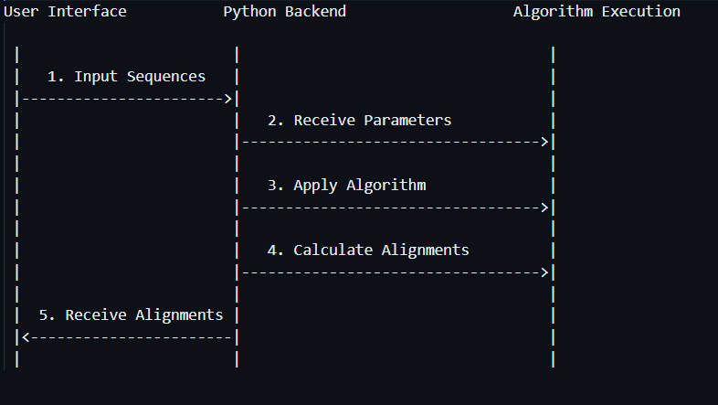
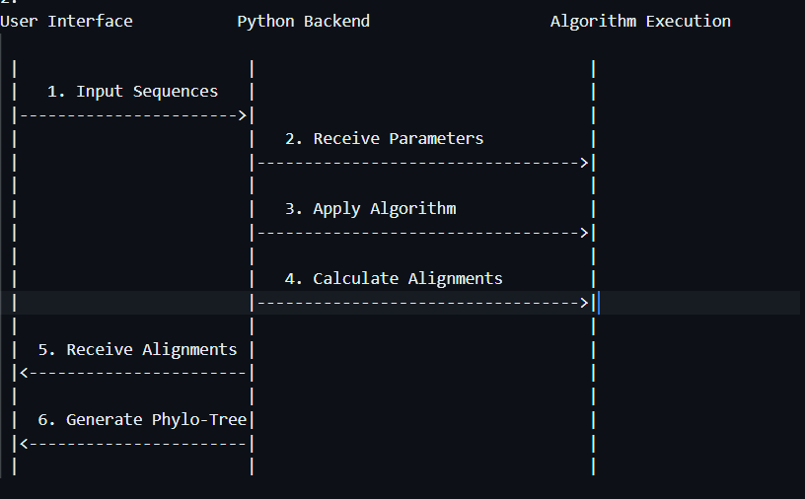
Use cases
Get global/local alignments between 2 sequences using Needleman-Wunsch / Smith-Waterman algorithm
Information flow: take input from user form -> send it to the RabbitMQ queue -> send the parameters to Python backend -> apply the algorithm at the backend -> Send output alignments back to the frontend
Get alignments between multiple sequences using ClustalW Algorithm
and generate phylogenetic tree (if required)
Information flow: take input sequences from user form -> send it to the RabbitMQ queue -> send the parameters to Python backend -> apply the algorithm at the backend -> using generated alignments, create a phylogenetic tree -> Send output alignments and phylogenetic tree back to the frontend

Slide 5
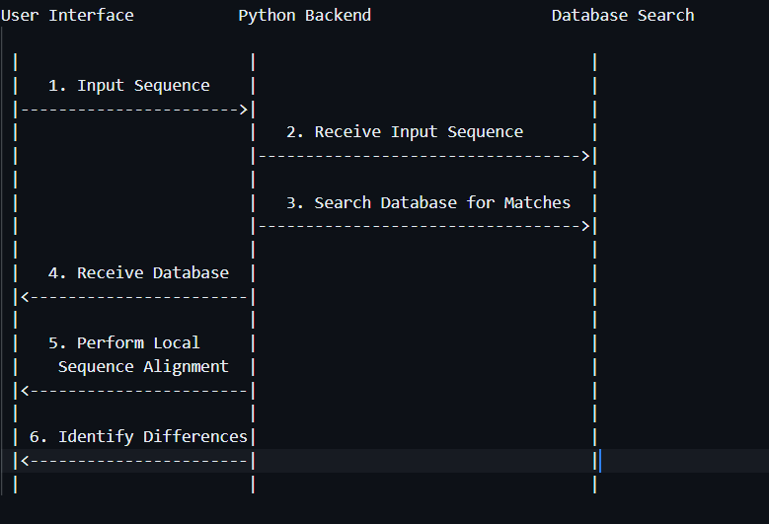
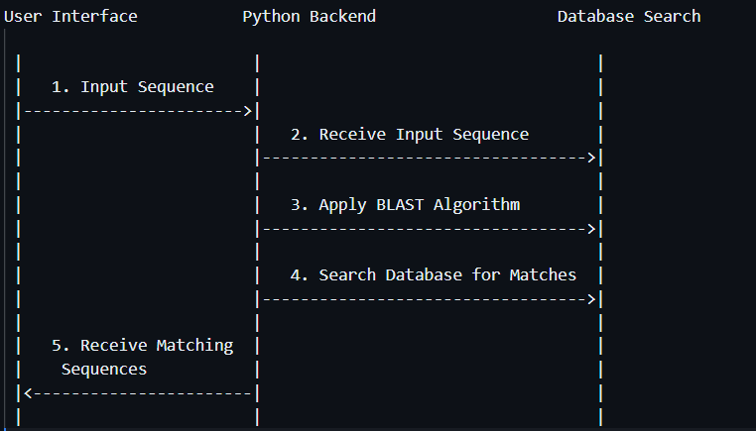
Use cases
3. Use variation analyzer to identify how a regional variant of a gene differs from the reference genome
Information flow: take input sequence from the user -> search the database for matching sequences to return the region it belongs to -> perform BLAST against reference genome to identify regions of similarity and then identify the minute differences
4. Find sequences that are similar to the input sequence using BLAST algorithm
Information flow: take input sequence from user -> apply a local alignment-based search algorithm across all the sequences in the database -> return all the sequences that match sufficiently

Slide 6
Non-Functional Requirements
- Usability requirements: To work on all devices/browsers that can access the browser and be able to provide FASTA files as inputs. The tool should also be user-friendly.
- Performance-related requirements: Response time of <2 minutes for a given input.
- Security related requirements: Only allow authenticated genomic researchers to access the browser. The researchers should be able to access only the relevant parts of the genome

Slide 7
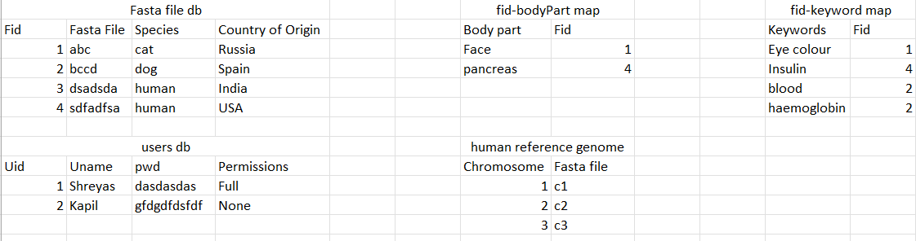
Database Model

Slide 8
Biopython
Multiple sequence alignments, AlignIO
Phylo - Working with Phylogenetic Trees
Handling sequences with the Seq class.

Slide 9
References
https://www.ncbi.nlm.nih.gov/
https://genome.ucsc.edu/index.html
https://www.ebi.ac.uk/

Slide 10
Discussions so far
We have had a few meetings with sir to understand his requirements better.
We also talked to people from IISER Pune for their technical insight.
Got feedback from sir to consider comparative analysis on genomes of people across various regions.
Also asked to create a mapping between sequences and the body part they
affect

Slide 11
Tasks Completed
Pairwise alignment
Basic UI structure
Accepting user fasta files
Alignment viewer
Dockerization
Database implementation
BLAST
Search implementation
Phylogenetic tree generator
Multiple Sequence Alignment

Slide 12
Work Distribution
Shreyas:
Backend tools
Database
Kapil:
Frontend Web dev
Integrating everything together
Dockerization

